Slide 1


Introduction to convolutional Neural Networks
Artemiy Firsov

Slide 2
5 minutes questionnaire
What is a local feature?
4 characteristics of the local feature
2 types of features
Corner prop
Harris detector
Derivative matrix
How to deal with local feature scale?
Difference of Gaussians (DoG)
What is the local feature descriptor?

Slide 3
prerequisites
I assume that you know
What a neuron is
Different activation functions
How to get features from NN
What the MLP is
What the softmax is
What the epoch, hidden layer, cross-entropy are
ML basics – classification, regression, etc + algorithms (SVM/KNN/KMeans, etc)

Slide 4
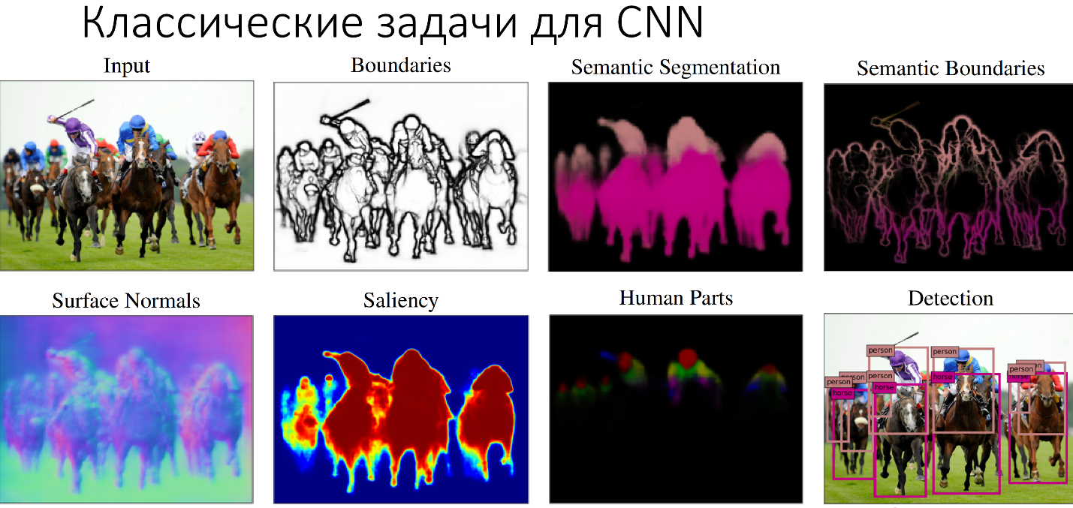
Classic cnn problems

Slide 5
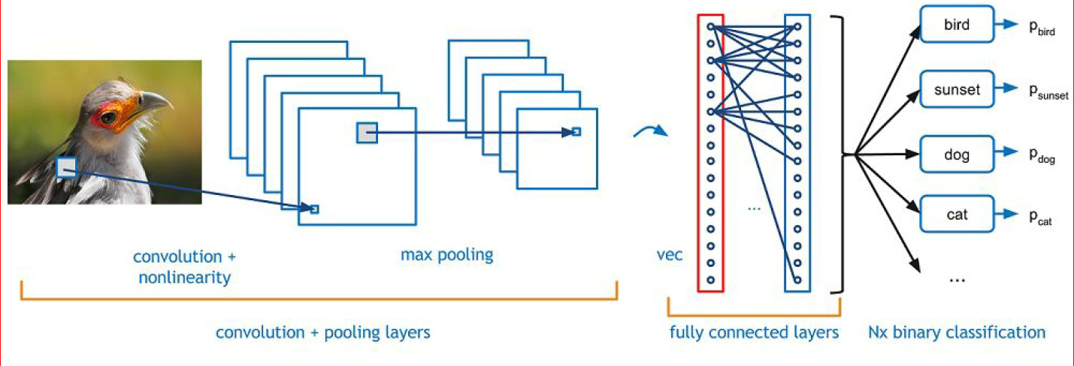
CNN

Slide 6
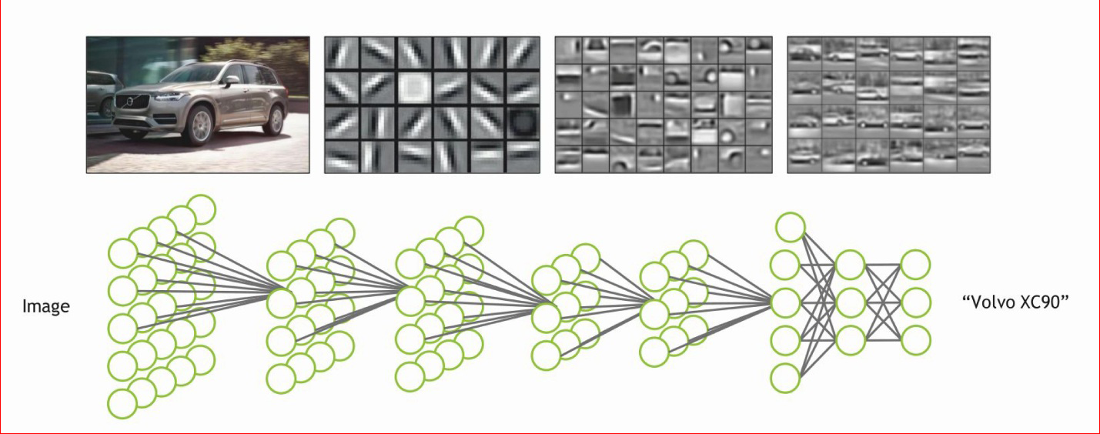
CNN
Good 3D visual representation of CNN

Slide 7
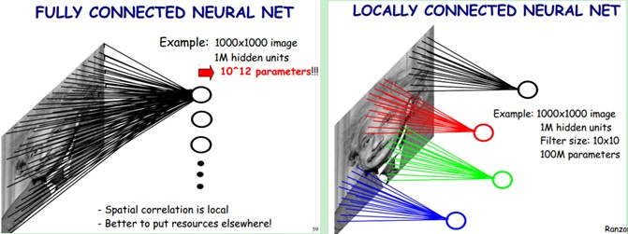
Cnn benefit

Slide 8
Convolution layer

Slide 9
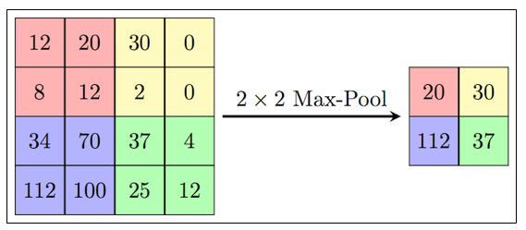
maxpooling

Slide 10
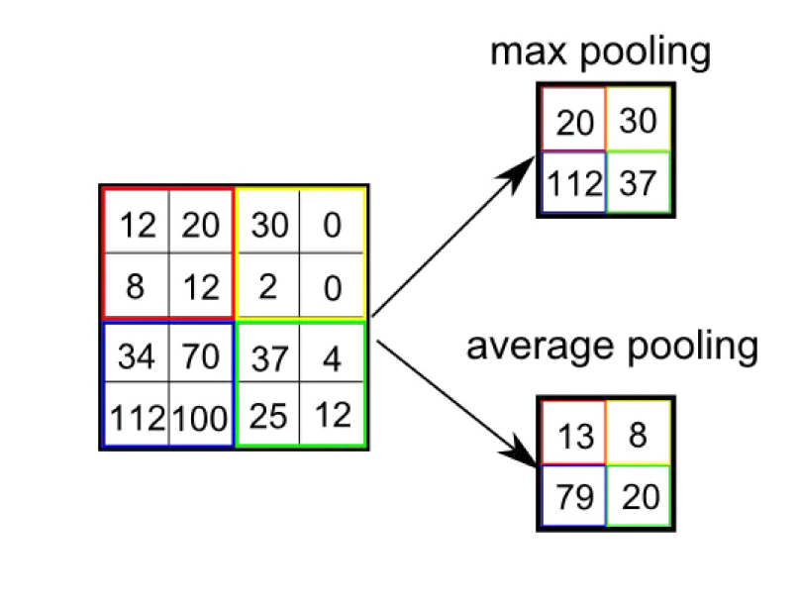
Average pooling

Slide 11
Max vs average
Max – gives shift invariance
Average – preserves information about low activations

Slide 12
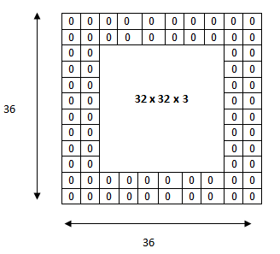
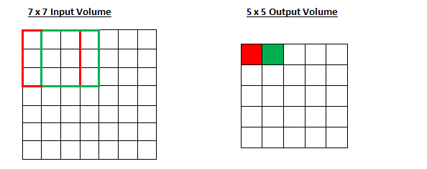
Stride and padding
Stride
Padding

Slide 13
Datasets
What is the size of an image for a human to understand what is in it?

Slide 14
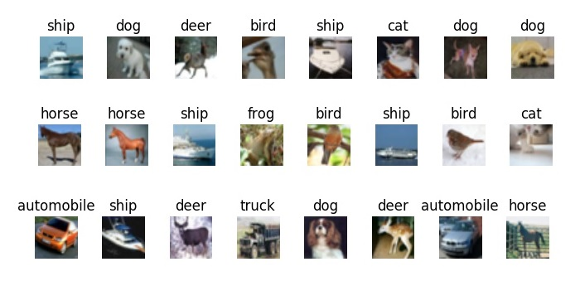
Tiny images
80 million of images
32х32 pixels
http://groups.csail.mit.edu/vision/TinyImages/

Slide 15
Tiny images
80 million of images
32х32 pixels
http://groups.csail.mit.edu/vision/TinyImages/

Slide 16
Cifar-10, cifar-100
Extracted from Tiny Images
CIFAR-10
60000 picture (50.000 train/10.000 test)
32х32 pixels
10 classes - 6.000 pictures in each
CIFAR-100
6000 pictures(5.000 train/1.000 test)
32х32 pixels
100 classes - 600 pictures in each
https://www.cs.toronto.edu/~kriz/cifar.html

Slide 17
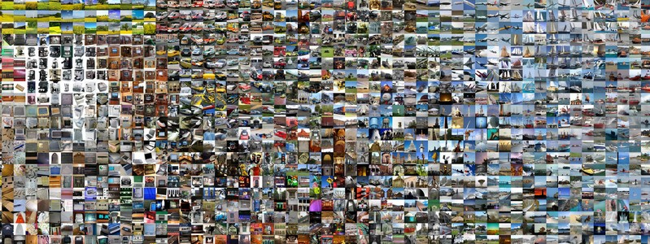
ImageNET
Structured using WordNET ontology
15 million pictures
20.000 categories - is this enough?
http://www.image-net.org/
https://wordnet.princeton.edu/

Slide 18
ImageNET
Structured using WordNET ontology
15 million pictures
20.000 categories – in English language there are 100.000 categories
http://www.image-net.org/
https://wordnet.princeton.edu/

Slide 19
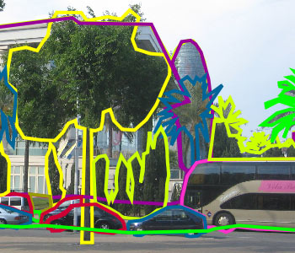
How to gather dataset?
By yourself ))
Open datasets
Download
Volunteers
LabelMe
Common Voice
Freelancers
Yandex Toloka
Amazon Mechanical Turk
Automatically
Youtube
VK
…

Slide 20
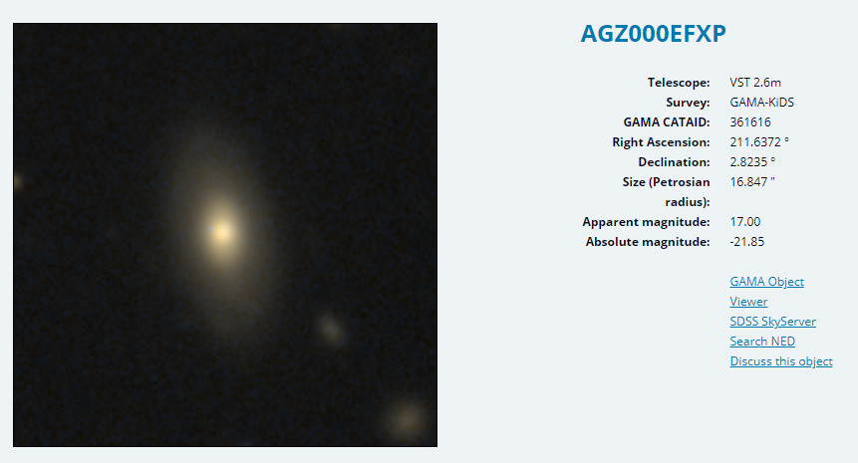
Galaxy project
Started in 2007
By 2008, they had 60.000.000 of labels
150.000 volunteers

Slide 21
Training problems
Dead neurons – always the same output value
Saturation (low gradients) – very low weight change
Which activation functions have these problems?

Slide 22
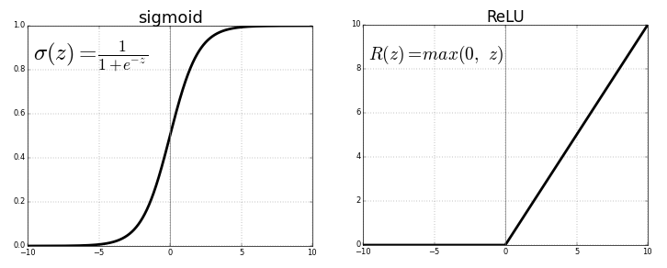
Training problems
Dead neurons – always the same output value
Saturation (low gradients) – very low weight change
Which activation functions have these problems?

Slide 23
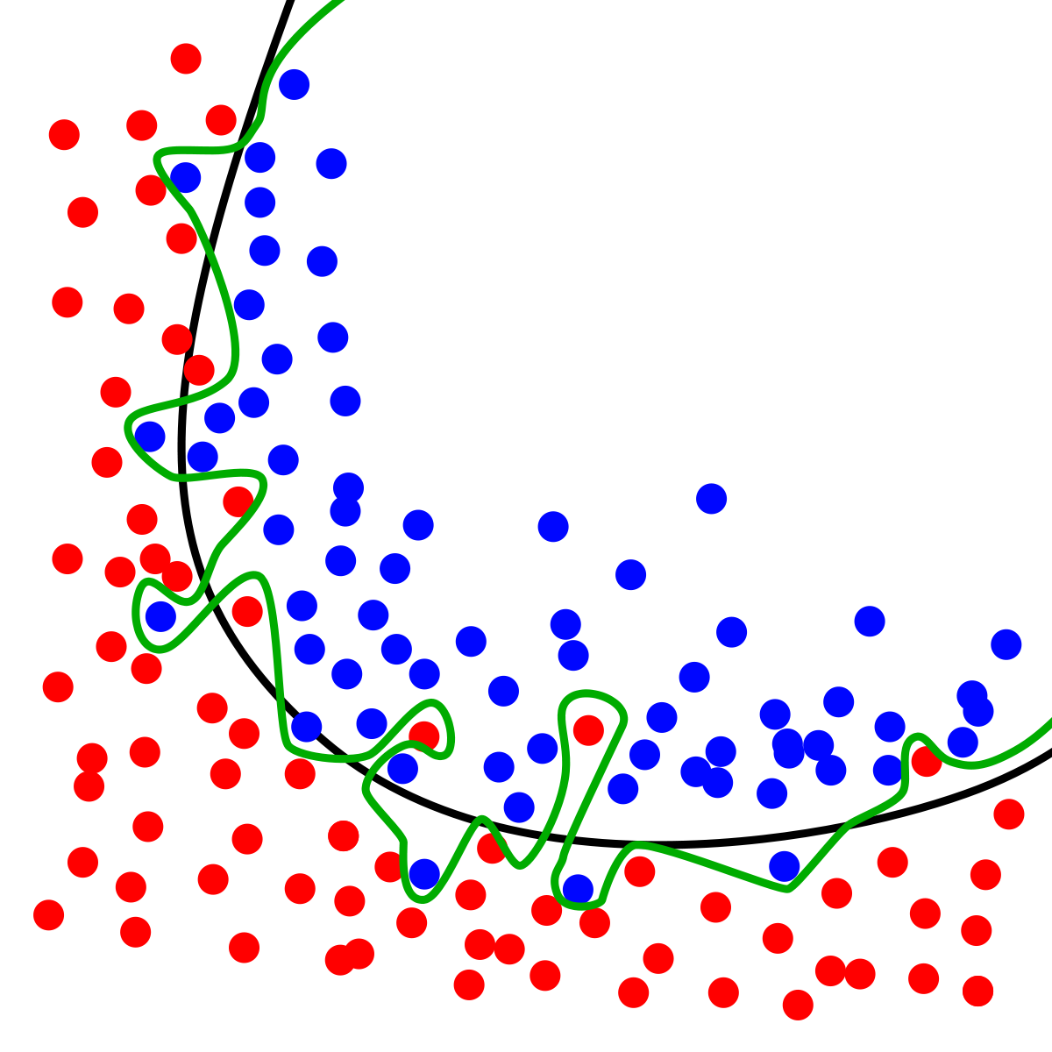
overfitting
Symptom:
Model performs well on training data, but fails on test data

Slide 24
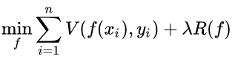
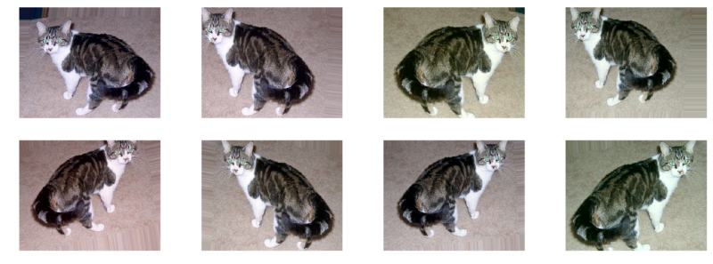
overfitting
Symptom:
Model performs well on training data, but fails on test data
Solution:
Regularization
Get more data
Augment data
Apply dropout technique
Decrease architectural
complexity
Batch Normalization

Slide 25
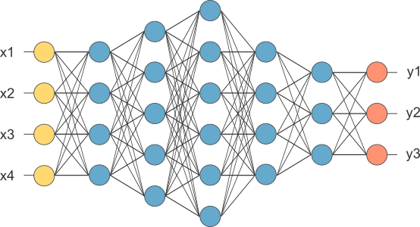
Features from NNs

Slide 26
Features from NNs

Slide 27
Features from NNs
KNN SVM
…..

Slide 28
Features from NNs
Train with new outputs

Slide 29
Features from CNN

Slide 30
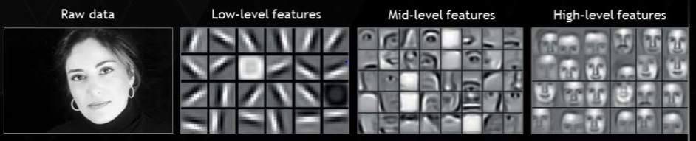
Filter visualization

Slide 31
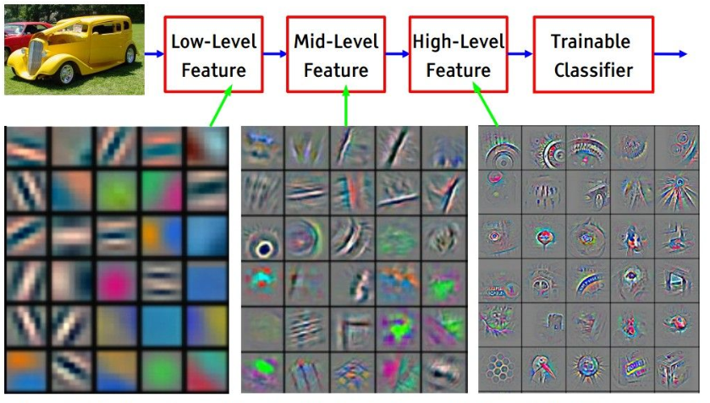
Rgb filter visualization

Slide 32
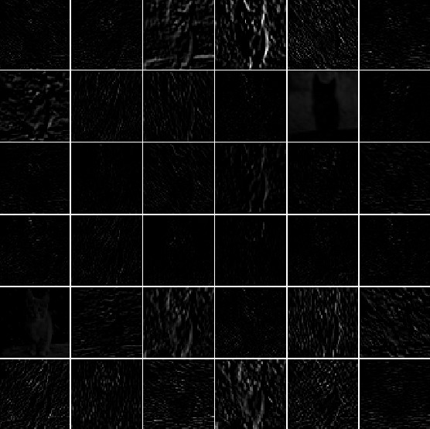
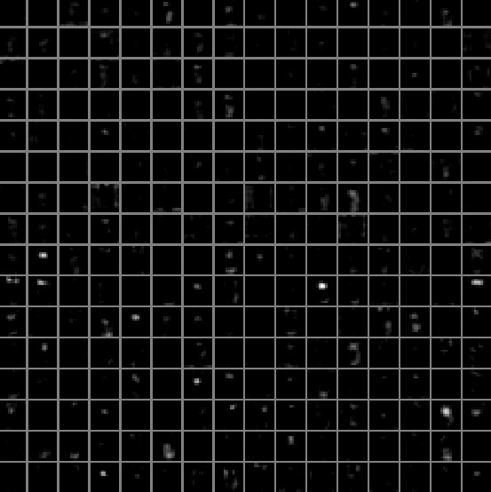
Activation visualization
First layer
Fifth layer

Slide 33
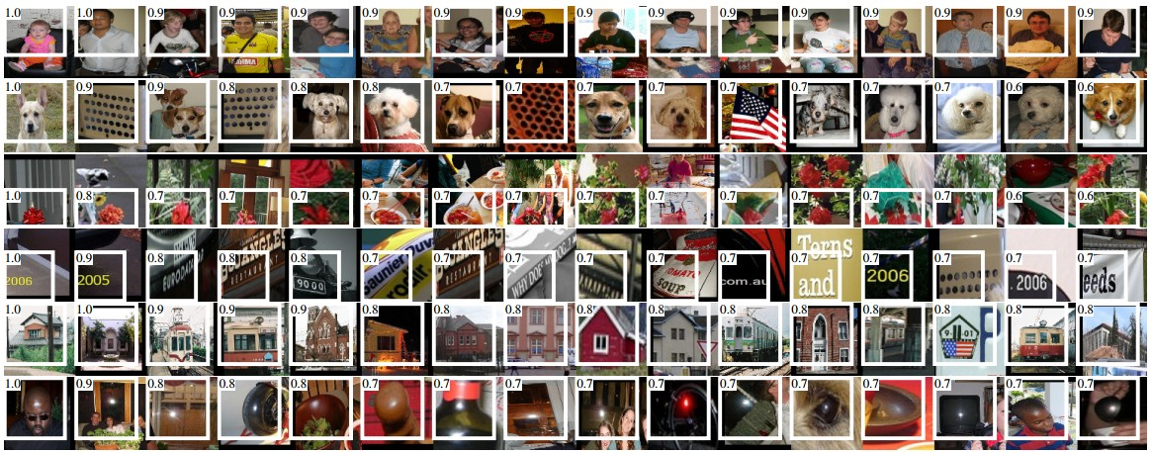
Maximal neuron activation

Slide 34
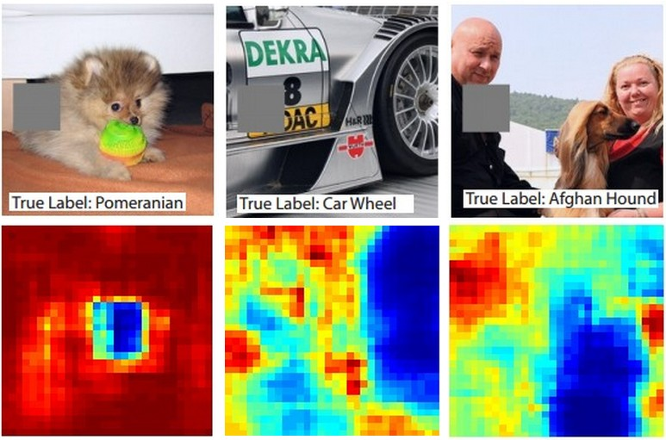
Visualization of important data

Slide 35
Visualization of neuron stimulus
Can understand what part of the image caused the activation of the neuron
https://arxiv.org/pdf/1311.2901.pdf

Slide 36
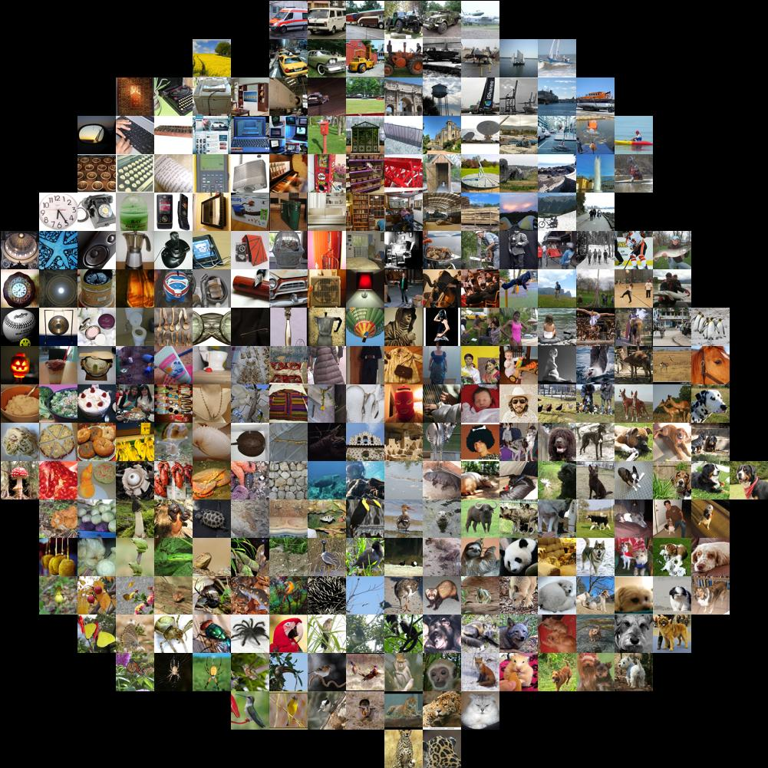
tSNE

Slide 37
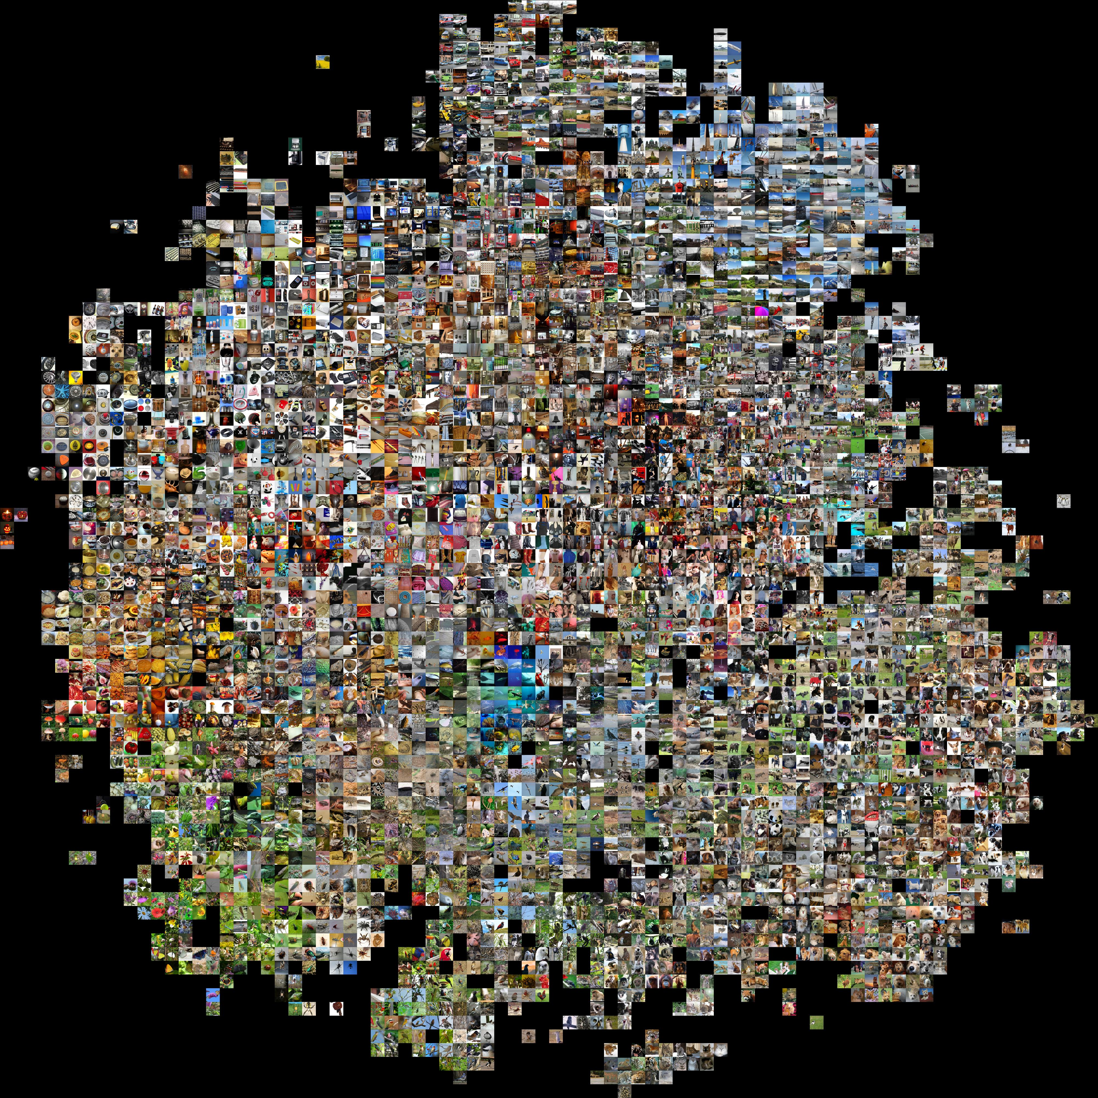

Slide 38
Reconstruction of the image

Slide 39
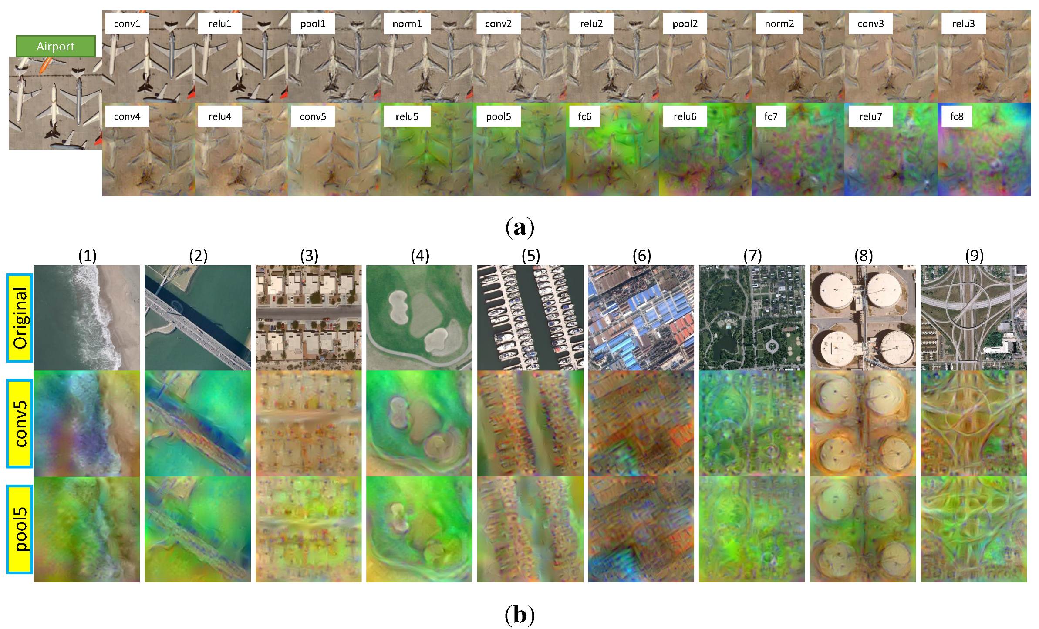
Реконструкция изображения

Slide 40
Reconstruction of the image
Fully connected layer preserves semantics, but loses spatial information

Slide 41
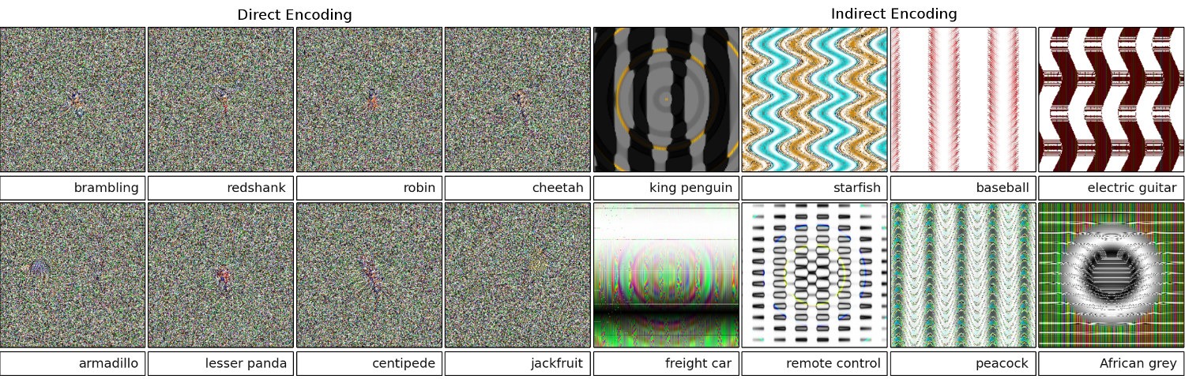
How to trick cNN
https://github.com/Evolving-AI-Lab/fooling

Slide 42
Frameworks of Cnns visualization
Tensorflow - https://github.com/InFoCusp/tf_cnnvis
Keras - https://github.com/raghakot/keras-vis
Caffe - https://github.com/yosinski/deep-visualization-toolbox

Slide 43
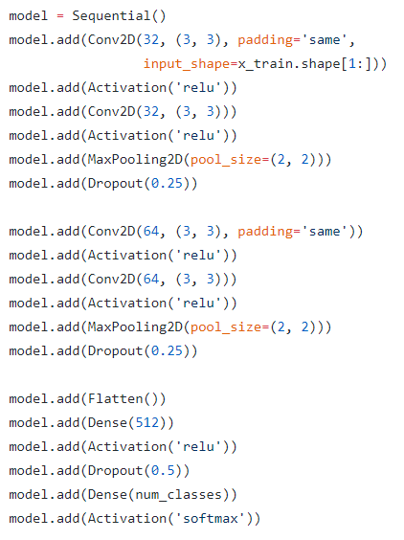
Cnn frameworks
Keras
Caffe
Tensorflow
Torch
PyTorch
Theano

Slide 44
Thank you!

